Slide 1

Actively Managed, Risk-controlled
High Quality Municipal Bond Strategy
High Grade Investment Solutions (HGIS)
High Grade Investment Solutions, LLC claims compliance with the Global Investment Performance Standards (GIPS) and has prepared and presented this report in compliance with the GIPS standards. High Grade Investment Solutions has been independently verified for the periods December 31, 2006 through November 30, 2015. The verification report is available upon request. Verification assesses whether (1) the firm has complied with all the composite construction requirements of the GIPS standards on a firm-wide basis and (2) the firm’s policies and procedures are designed to calculate and present performance in compliance with the GIPS standards. Verification does not ensure the accuracy of any specific composite presentation.
555

Slide 2
High Grade Investment Solutions, LLC (HGIS)
    Registered Investment Adviser: State of New York
    Founded in February 2007 by Michael Brown to:
      Capitalize on inefficiencies in the Municipal bond market
      Concentrate on the preservation of an investor’s principal
      Manage high quality, liquid portfolios for tax-advantaged investors
      Maximize the after-tax total return of a portfolio while controlling risk
Annualized net-of-fees total-return since inception
    2017 net-of fees Total-Return = + 3.76%
    2017 Gross Income Earned = + 1.55%
    2017 Gross Price Return = + 2.62%
    *2017 Market (benchmark) Total-Return = +3.16%
2017 Performance Breakdown
Informia Solutions *PSN “Top Gun” recognition
    HGIS = 5.57%
    *Market = 3.74%
    *PSN TOP GUN QUARTERS
    2010 Qtrs. 2ND, 3RD, 4TH
    2011 QTRS 1st , 2ND , 3rd
    2014 QTRS 1st
    2016 QTRS 4TH
    8 TIMES
HGIS inception 02/01/2007 thru 12/31/2017
* BENCHMARK = Bloomberg Barclays 5-year Muni Bond index.
* PSN is an investment manager performance database provided by Informa Investment Solutions, Inc. It is the longest running data base in North America. The PSN Top Guns performance rankings are tabulated for thousands of strategies across 58 peer groups through rigorous screenings. It awards the Top Guns status every quarter to the top 10 performers within one or more peer groups. The data base tracks more than 2000 money management firms and over 12000 investment products. For more information, visit www.informais.com
Notes:
Emphasis on conservative assets in you total net worth…diversification….principal preservation…

Slide 3
Comparing Tax-Exempt Investment Strategies
Passive Management “buy and hold”
HGIS Active Management
Value Added through Active Management
1-Concentrates on maximizing total-return through active duration management.
2-Portfolio managed optimally, adding value by taking advantage of the pricing inefficiencies and curve value opportunities in the sector.
END RESULT: Tax-free income stream, realized price return, controlled risk and alpha generation (added value)
1-Concentrates on tax-exempt interest income
2-Managed tax-efficiently, limited in realizing market opportunities that can add value above market returns
END RESULT: Tax-free income stream
Alpha
Market Price Return
Tax-free Interest Income

Slide 4
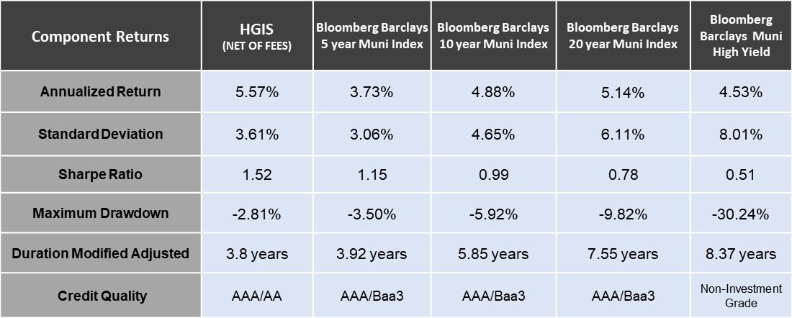
ACTIVE MANAGEMENT RELATIVE TO MARKET BENCHMARKS
Past Performance is not a forecast of future returns. HGIS inception 02/01/2007 through 12/31/2017. HGIS RETURNS ON CHART ARE NET-OF-FEES AND INCLUDE ALL DIRECT TRADING EXPENSES. PERFORMANCE TRACKRECORD AVAILBLE UPON REQUEST

Slide 5
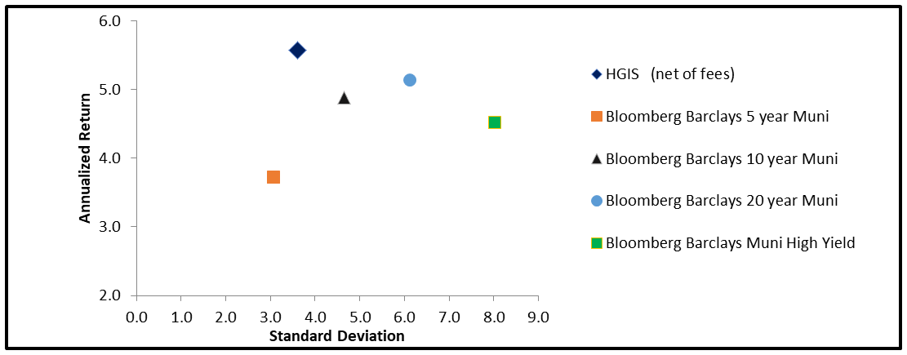
Risk-Reward
Past Performance is not a forecast of future returns. HGIS inception 02/01/2007 through 12/31/2017. HGIS RETURNS ON CHART ARE NET-OF-FEES AND INCLUDE ALL DIRECT TRADING EXPENSES. PERFORMANCE TRACKRECORD AVAILBLE UPON REQUEST

Slide 6
How Do We Do It?
Active
Security Selection
Active
Curve Positioning
Active
Credit Selection
  Buy high quality bonds at under-valued prices and sell at over-valued prices (Trade Compression)
  The ability to position and re-position a portfolio to the optimal maturities along the yield curve that offers the best relative value
  Purchasing “Best Choice” for a client’s portfolio factoring in the benefits of state exemption on out-of-state bonds

Slide 7
Personal and Contact Information
To obtain a performance track-record or for further inquiries, please contact:
High Grade Investment Solutions
Michael Brown
mbrown@hginvestments.net
www.hginvestments.net
845.290.0465
5 Fleetwood Avenue
Spring Valley, NY 10977

Slide 8
Important Disclosure
**HGIS Total-Return/AFTER-TAX returns are supplemental information to this GIPS compliant presentation
Compliance Statement
High Grade Investment Solutions, LLC claims compliance with the Global Investment Performance Standards (GIPS) and has prepared and presented this report in compliance with the GIPS standards. High Grade Investment Solutions has been independently verified for the periods December 31, 2006 through November 30, 2015. The verification report is available upon request. Verification assesses whether (1) the firm has complied with all the composite construction requirements of the GIPS standards on a firm-wide basis and (2) the firm’s policies and procedures are designed to calculate and present performance in compliance with the GIPS standards. Verification does not ensure the accuracy of any specific composite presentation.
Definition of the Firm
High Grade Investment Solutions, LLC (HGIS) is an independent investment advisory firm registered in the State of New York that provides discretionary fixed income portfolio management to high net-worth and institutional clients. The firm was established in February 2007 to provide investors with a risk-controlled, high quality, actively managed Municipal Bond asset preservation strategy. The investment objective is to maximize the total after-tax return. The firm’s office is located in Chestnut Ridge, New York, 25 miles northwest of New York City.
Formal Description of the Active Managed / Risk Controlled Quality 5-year Municipal Bond Composite
The composite includes all fully discretionary, fee-managed portfolios invested in high quality Municipal bonds with credit ratings of AAA and AA by one of the three major rating agencies. Each portfolio is managed to a +/- 4 year weighted average duration. The benchmark is the Barclays 5-year Municipal Bond Index.
Calculation Methodology
HGIS calculates returns using the TIME- WEIGHTED rate of return (TWRR) methodology.
Benchmark
The Barclays Municipal Bond Index is a widely used broad based performance measurement of the tax-exempt marketplace. Investors use the index to measure relative total return performance for their select duration (risk) profile. The 5-year Barclays Municipal Index consists of investment grade tax-exempt general obligation bonds, revenue bonds, pre-refunded bonds and insured bonds with maturities of 4 to 6 years.
Fee Schedule and Transaction Costs
Gross-of-fees are presented before HGIS’s management fee but net of all trading expenses. The trading expense is $10 dollars per trade, charged by the custodian bank
Net-of-fees returns are calculated by deducting the management fee from the Gross-of-fees return. HGIS’s management fee is an annual fee structure of .40% (40 basis points).
Currency
Valuations are computed and performance results are reported in United States Dollars ($).
Policies
HGIS’s policies for valuing portfolios, calculating performance, and preparing compliant presentation are available upon request.
Measure of Dispersion
The composite’s dispersion is measured using an equal weighted standard deviation of the gross returns of all portfolios that are included in the composite for the entire year. HGIS is using the population form of the standard deviation.
Additional Information:
Additional information regarding HGIS’s policies and procedures for calculating and reporting performance results is available upon request.
All portfolios with an external cash flow are re-valued on the date of the external cash flow. All external cash flows will be re-calculated for complete accuracy of reporting over-all performance.
Tax-adjusted returns are calculated using federal marginal income tax rates in each period of 39.6% from 1/1/13 to date and 35.0% from inception to 12/31/12. Please note that various alternative calculations could apply to your specific situation.
Returns are calculated with interest reinvestment.
All after-tax returns do not reflect the impact of state and local taxes on out-of-state investments.
The composite has beginning and ending month-end and annual valuation dates. Annual valuation dates are the last business day of the year. Month-end valuations are the last business day of the month.
Composite only includes accounts that have a full month of performance.
High Grade Investment Solution’s strategies do NOT employ leverage or derivatives.
The minimum portfolio size for inclusion in the composite is $200,000.
A complete list of composite descriptions is available upon request.
Account information has been compiled solely by High Grade Investment Solutions, LLC, and has not been independently verified. In preparing this report, High Grade Investment Solutions, LLC has relied upon information provided by the accounts’ custodian(s).
Gross returns do not reflect the deduction of investment advisory fees; a client’s return will be reduced by the investment advisory fees and any other expenses incurred in the management of its investment advisory account. Management fees are individually negotiated with your primary advisor, and may not be the same for each client. On a compounded basis the investment performance would be diminished by the investment advisory fee. The collection of fees produces a compounding effect on the total rate of return net of management fees. As an example, the effect of investment management fees on the total value of a client’s portfolio assuming (a) quarterly fee assessment, (b) $500,000 investment, (c) portfolio return of 3.00% a year, and (d) .40% (40 basis point) annual fee. The ending dollar value of the account after ten years would be $649,122.14 compared to the unreduced account value of $671,958.19.. The annual investment advisory fee would be $2,000 in the first year, and cumulative effects of $10.575.8 over five years and $22,835.95 over ten year
Past performance may not be indicative of future results. Different types of investments involve varying degrees of risk. Therefore, it should not be assumed that future performance of any specific investment, investment strategy (including the investments and/or investment strategies recommended by High Grade Investment Solutions, LLC) or product will be profitable or equal the corresponding indicated performance level(s).

